Slide 1
People's Democratic Republic of Algeria Ministry of Higher Education and Scientific Research Ibn Khaldoun University of Tiaret computer science faculty
Presentation on SQLite DBMS
Realized by :
- Rahlaoui Lahcen
- Laoumir Mustapha AEK
Supervised by :
- Mme BEN OUTHMANE
2020/2021

Slide 2
Plan
Introduction & Présentation générale
Outil choisi & installation
Les langage & les interfaces
Sécurité & droits d’accés
Métadonnées & transaction
Avantage & inconvénients
Difficultés rencontrés durant le travail

Slide 3
Introduction &
Presentation

Slide 4
Introduction
A Database Management System (DBMS) is system software used to store, manipulate, manage, and share information in a database. It is the intermediary between the user and the database.
* Proprietary system
- Oracle Database
- Microsoft SQL Server
* Free system
- MySQL
- PostgreSQL
- MariaDB
* Embedded
- SQLite
* NoSQL
- MangoDB
- cassandra

Slide 5



Definition
Created by Dr Richard Hipp and published in August 2000
Written in C language
An open source library
Accessible by SQL language
Does not reproduce the usual client-server scheme but is directly integrated into programs.
Bibliothèque
SQLite
Fichier stocké
Importée et utilisée dans
le code

Slide 6
Use
SQLite is among the most used database engines in the world and can be found in:
Android mobile applications
Many consumer software such as Firefox, Skype, Adobe ...
Embedded systems (cell phones, televisions, cameras, planes, medical devices, etc.)

Slide 7
Chosen Tools

Slide 8





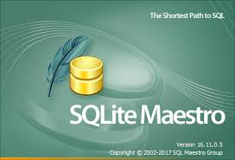
Tools
SQLite Tools :
DB Browser for sqlite
SQLite Expert
SQLite Studio
IceQuake SQLite Query Browser
SQLiteMan
SQLite Maestro

Slide 9

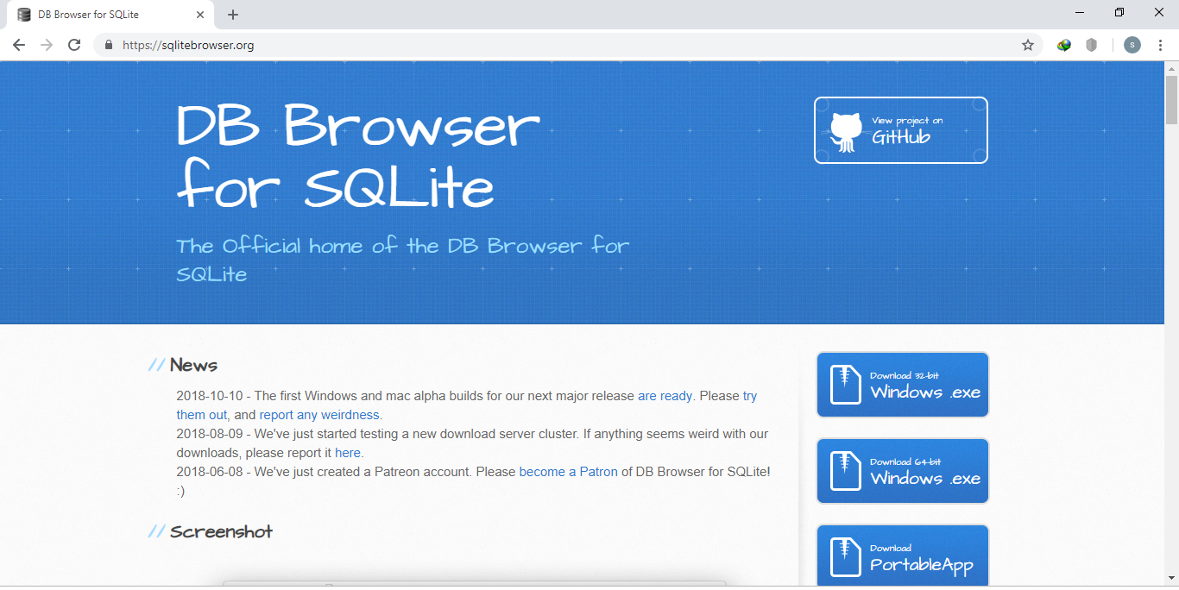
DB Browser for SQLite:
https://sqlitebrowser.org
Open source and visual Tool.
SQL Requests capable with results inspection.
High Quality Program allowing to
create, view and modify database
files that are compatible with SQLite.

Slide 10
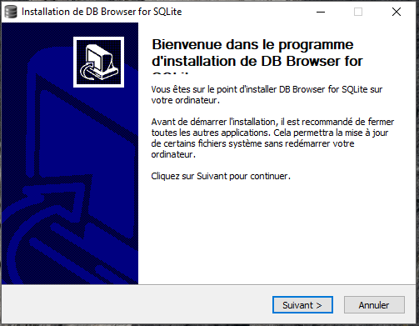
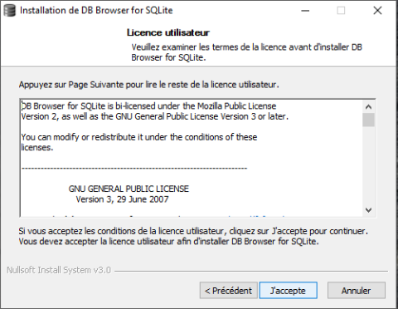
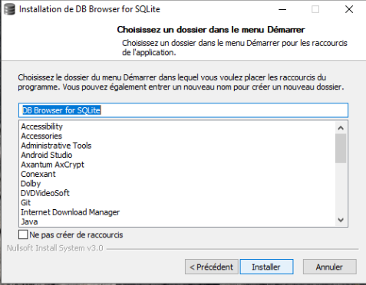
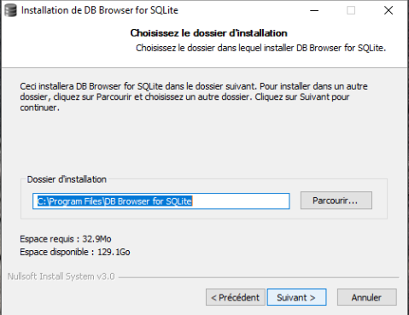
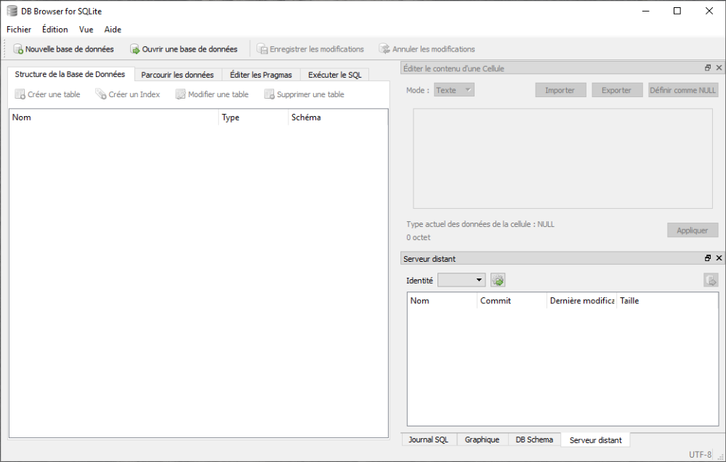
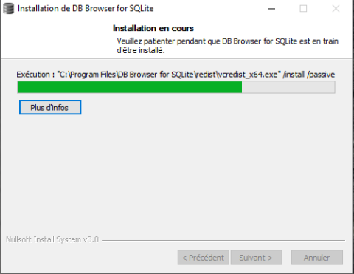
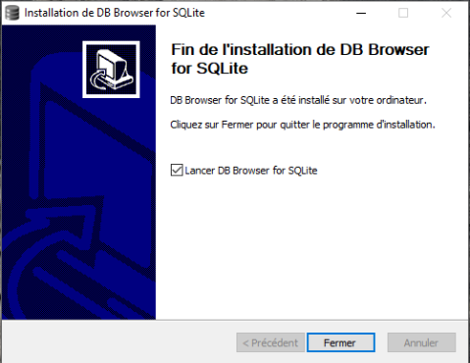
Installation

Slide 11
Languages &
Interfaces

Slide 12
DDL ( data definition language )

Slide 13
SQLite Languages
We will explain how to :
Create a DataBase.
Create, Delete and Alter a Table
Create, Delete and Alter an Index
Create and Delete a Vue
Create and Delete Triggers

Slide 14
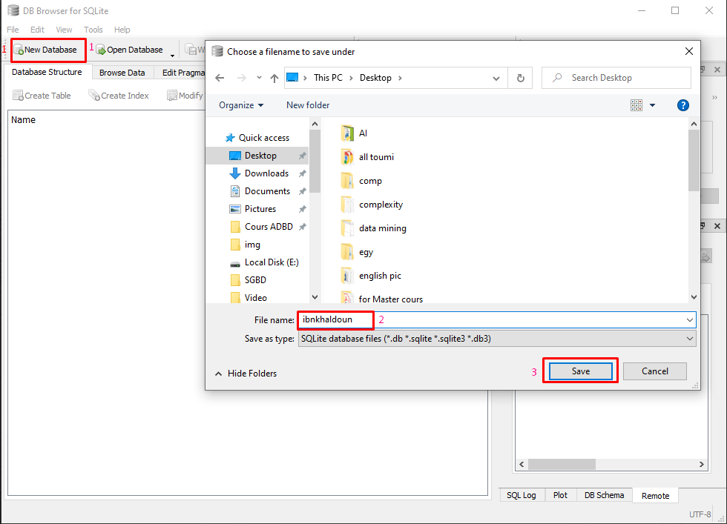
DB Creation
Click new Database
Name the Database
Save the Database

Slide 15
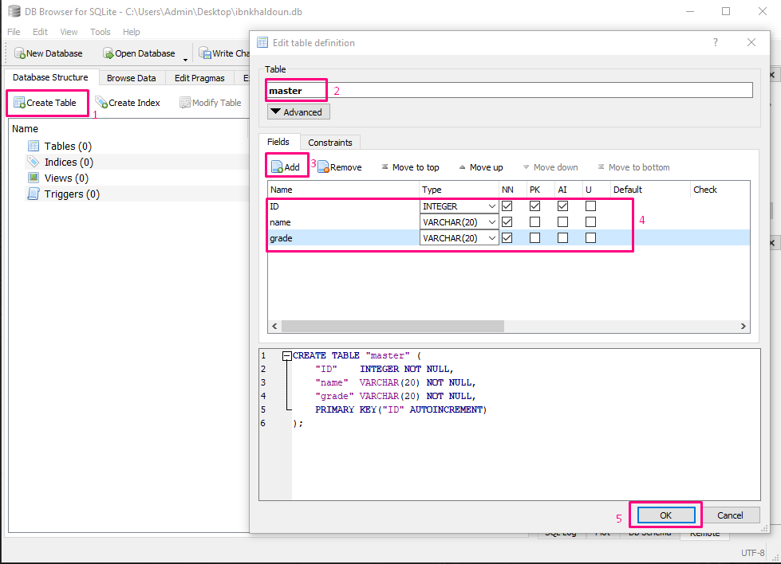
Table Creation
Click on create table
Choose a name
Click to add a column
Fill the attributes
Click “ok “ to save the table

Slide 16
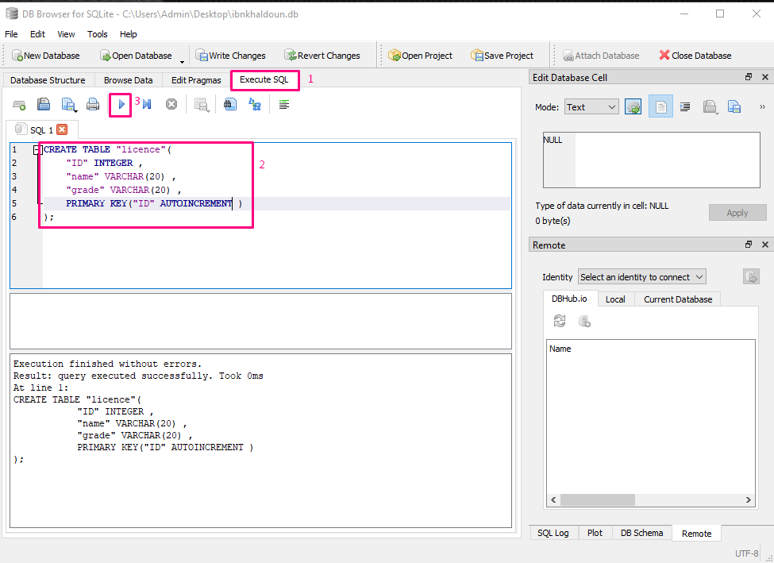
Table Creation
Click execute SQL
Write the query create table
Exute the code

Slide 17
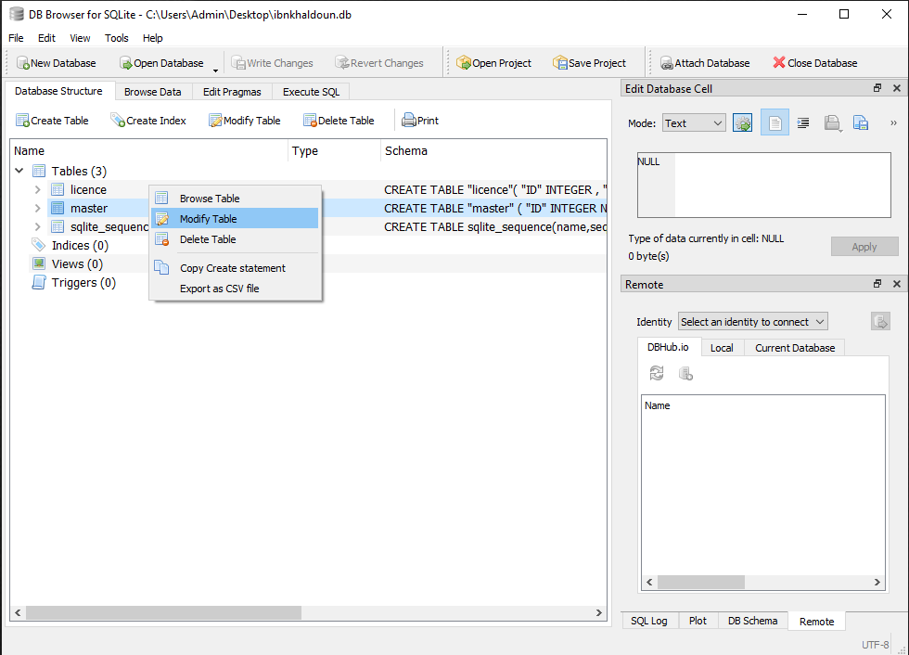
Table Modification
Right-click
Click on modify table

Slide 18
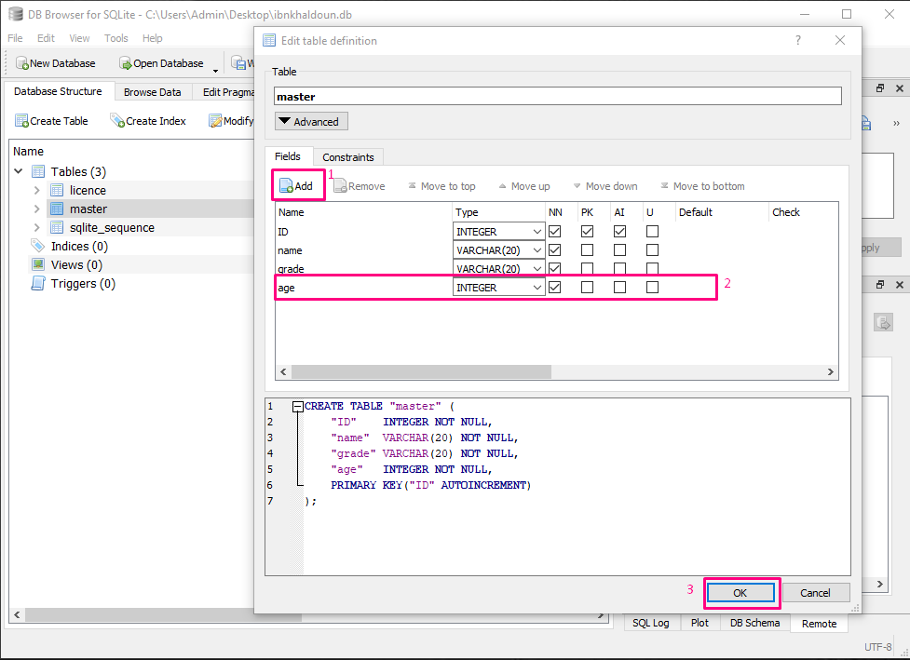
Table Modification
Click to Add a column
Fill the row
Click ok to save changes

Slide 19
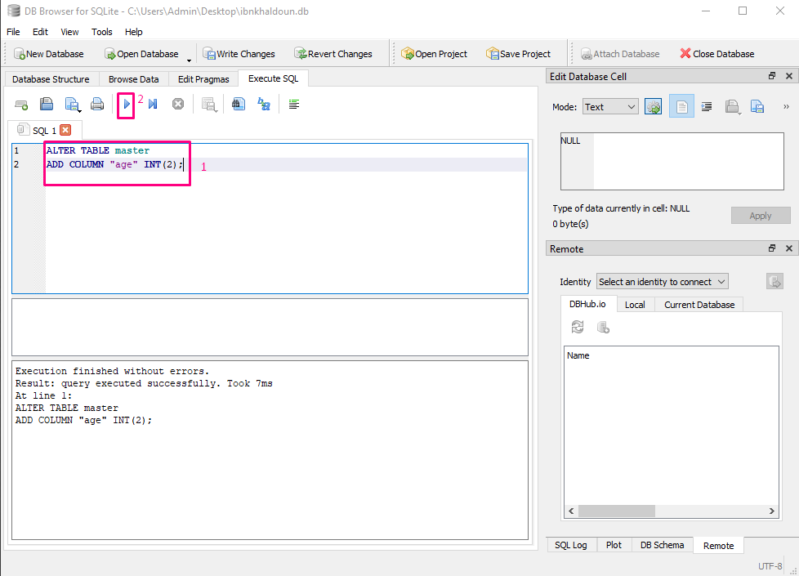
Table Modification
Write the query alter table
Execute the code

Slide 20
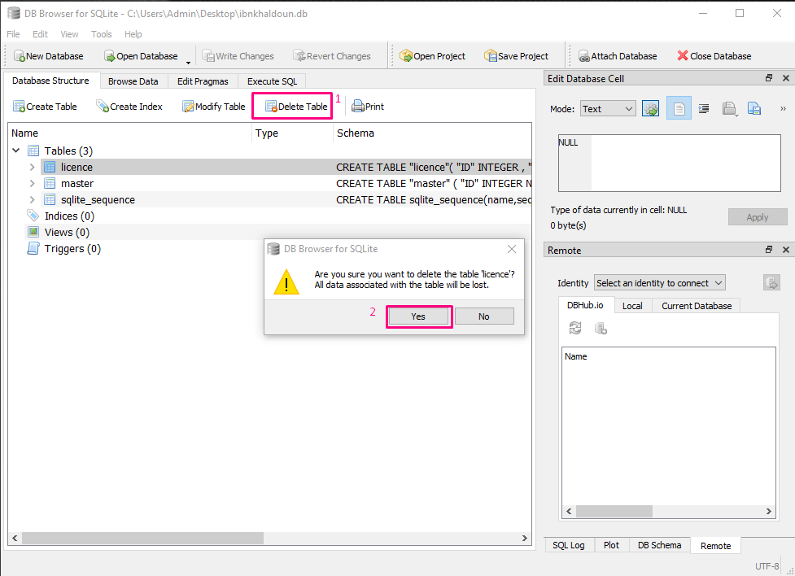
Table Suppression
Select table
Select delete table
Click yes

Slide 21
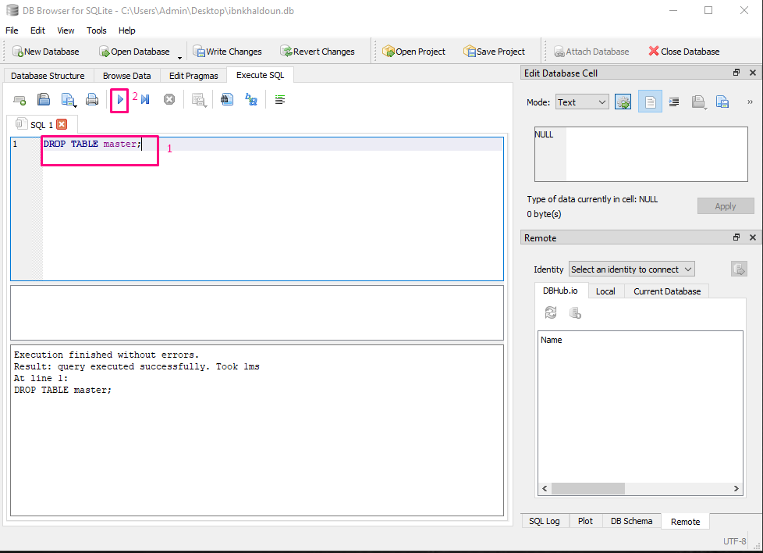
Table Suppression
Write the query drop table
Execute the code

Slide 22
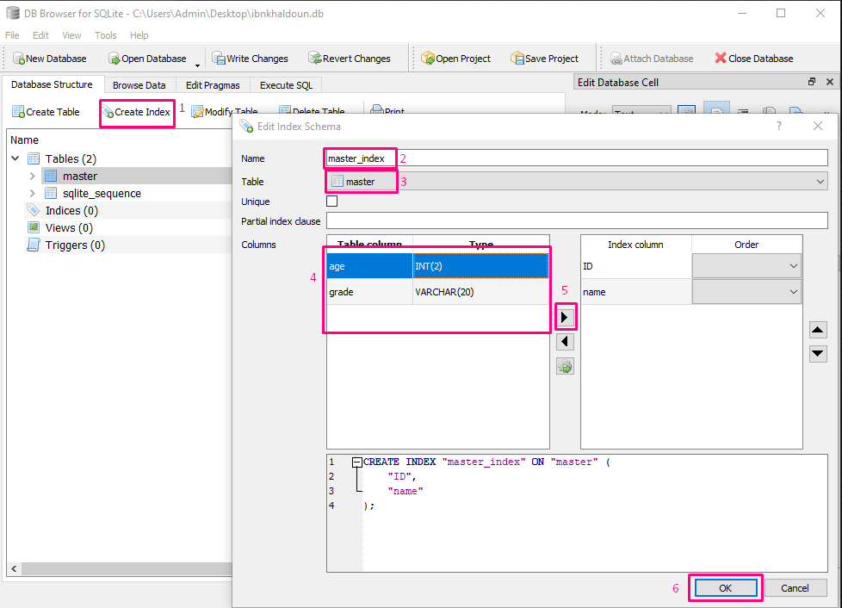
Index Creation
Click on create index
Give the index a name
Choose the table
Select the column
Click on the flesh button
Click “ok” to save the work

Slide 23
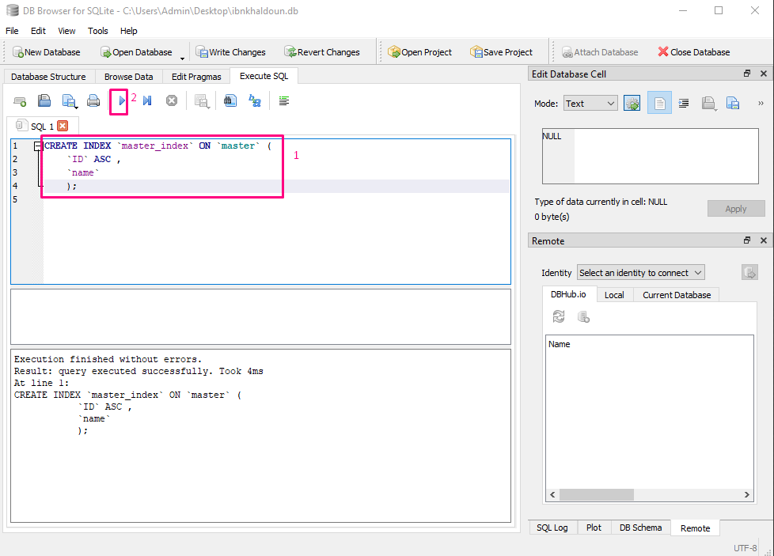
Index Creation
Write the query create index
Execute the code

Slide 24
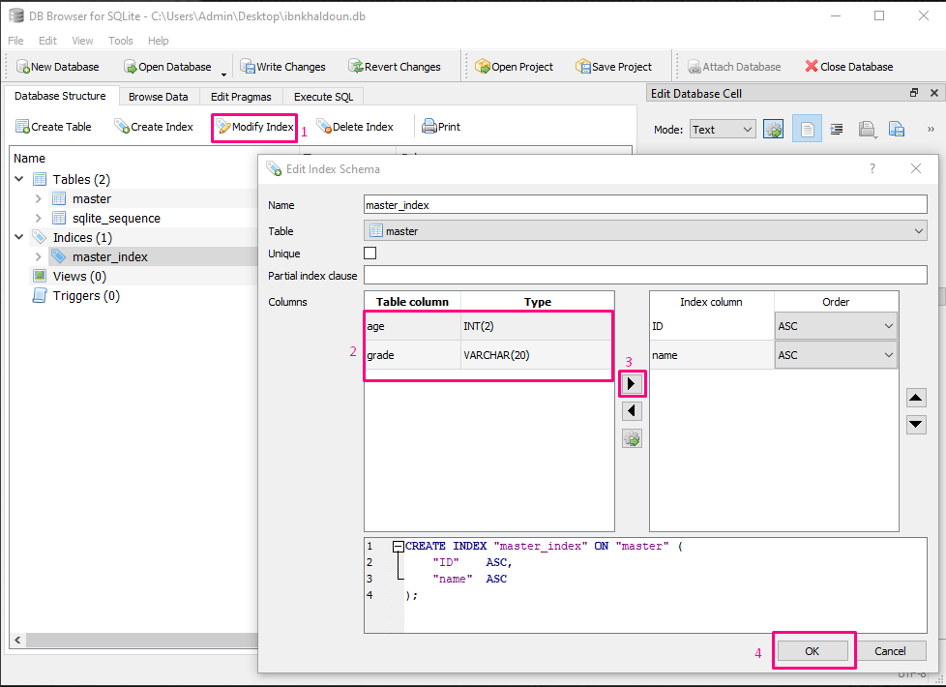
Index Modification
Click on modify index
Choose the column
Click the button
Then click “ok”

Slide 25
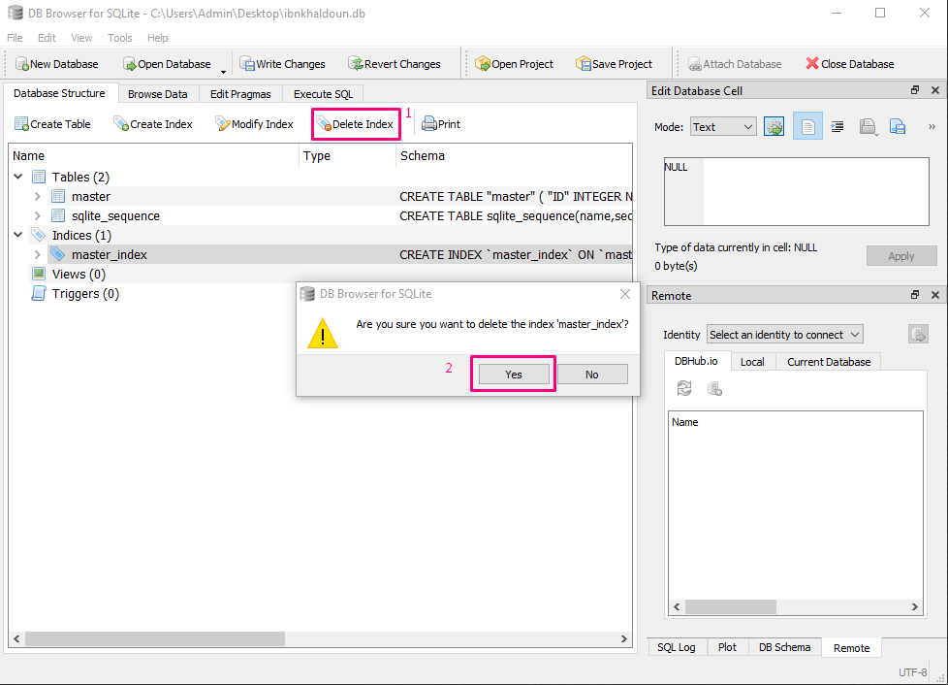
Index Suppression
Choose the index
Select delete index
Click “yes”

Slide 26
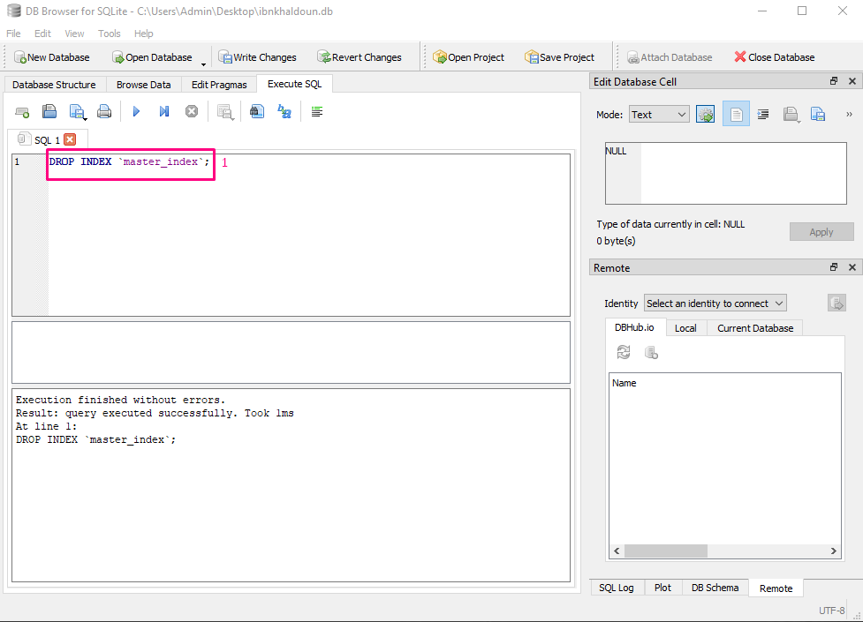
Index Suppression
Write the query drop index
Execute the code

Slide 27
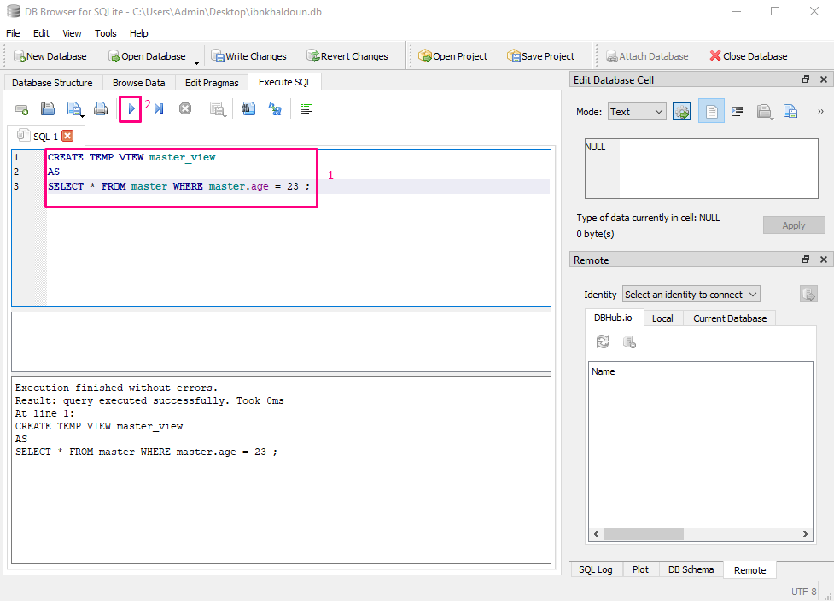
Vue Creation
Write the query create view
Execute the code

Slide 28
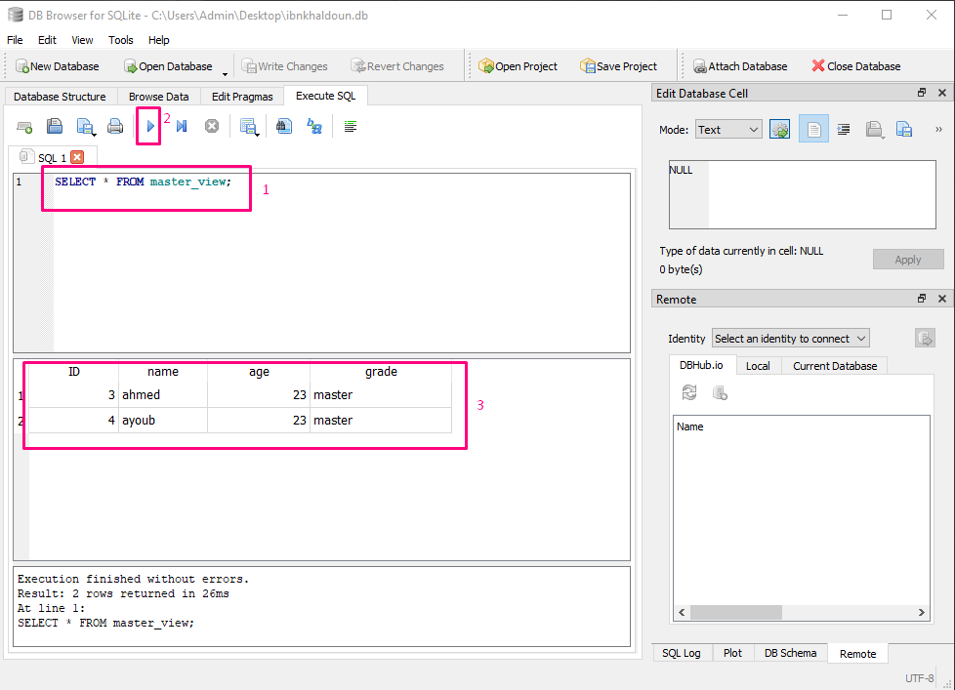
View usage

Slide 29
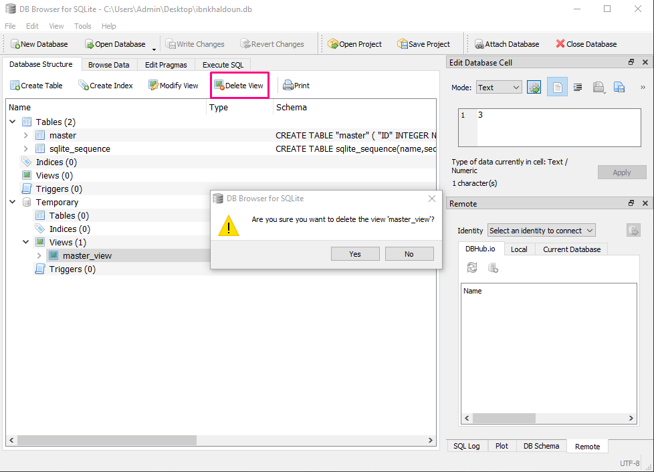
Vue Suppression
Select the view
Click on delete view
Click “ok”

Slide 30
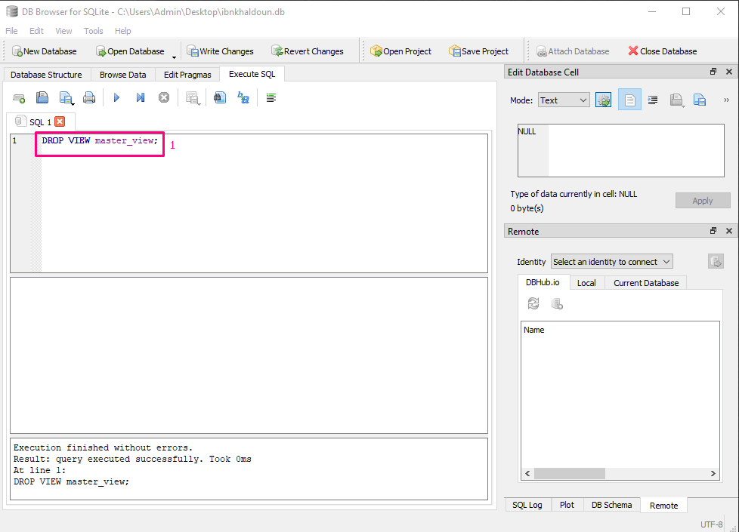
Vue Suppression
Write the query drop view
Execute the code

Slide 31
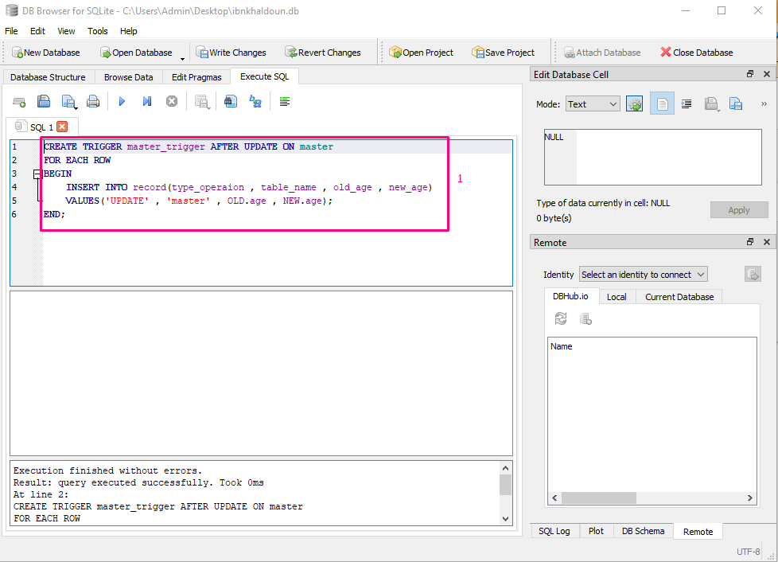
Trigger Creation
Write the query create trigger
Execute the code

Slide 32
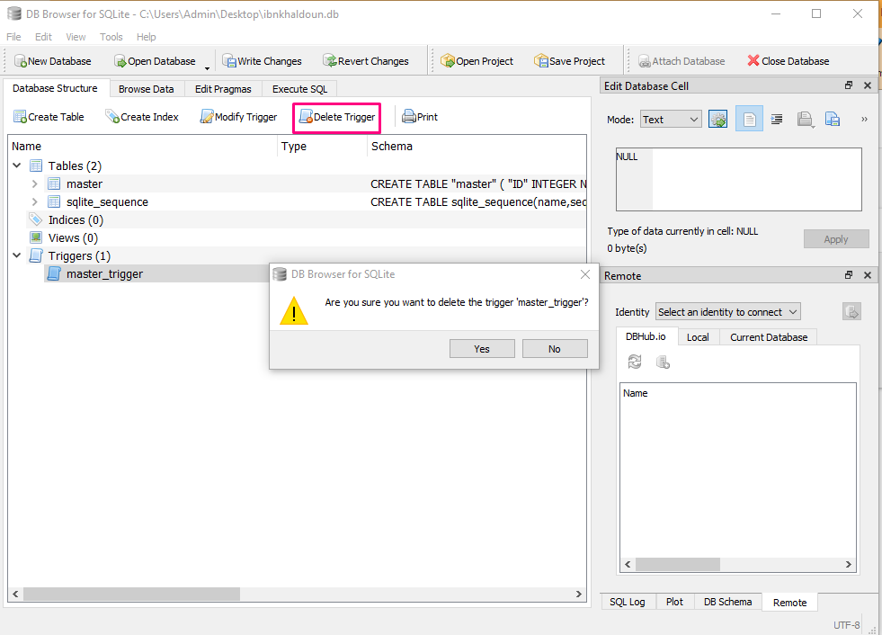
Trigger Suppression
Select the trigger
Click on delete trigger
Click “ok”

Slide 33
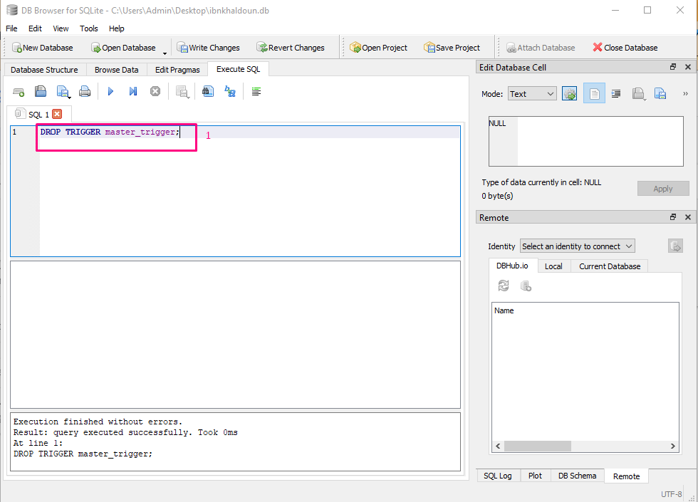
Trigger Suppression
Write the query drop trigger
Execute the code

Slide 34
DML ( data manipulation language )

Slide 35
SQLite Languages
We will explain how to do this:
Data selection
Data insertion
Data modification
Data deletion

Slide 36
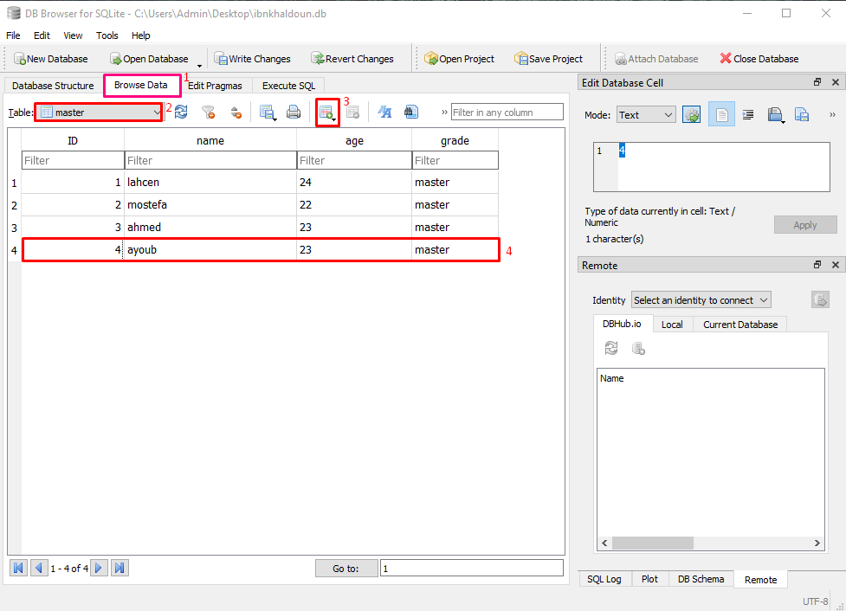
Data Insertion
Select on “browse data”
Select the table
Click on the button to add row
Fill the row with your data

Slide 37
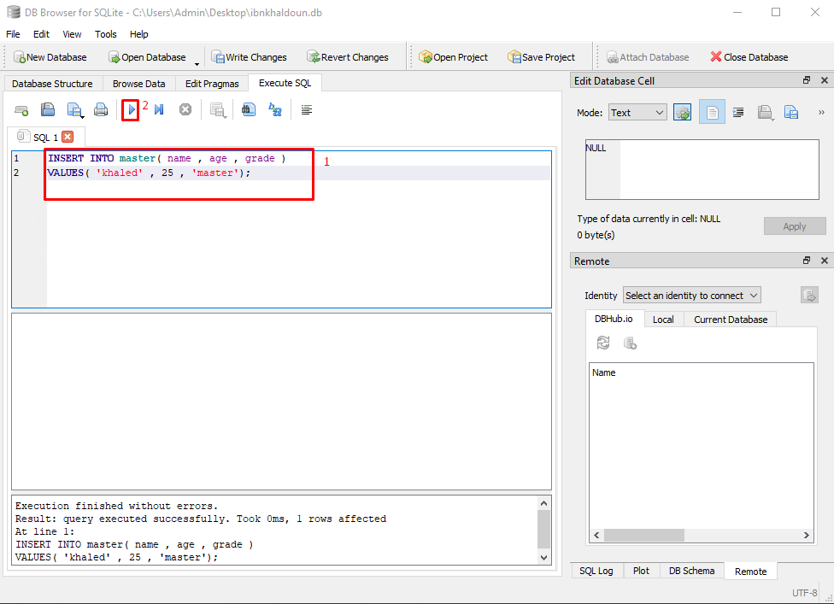
Data Insertion
Write the query “insert into”
Execute the code

Slide 38
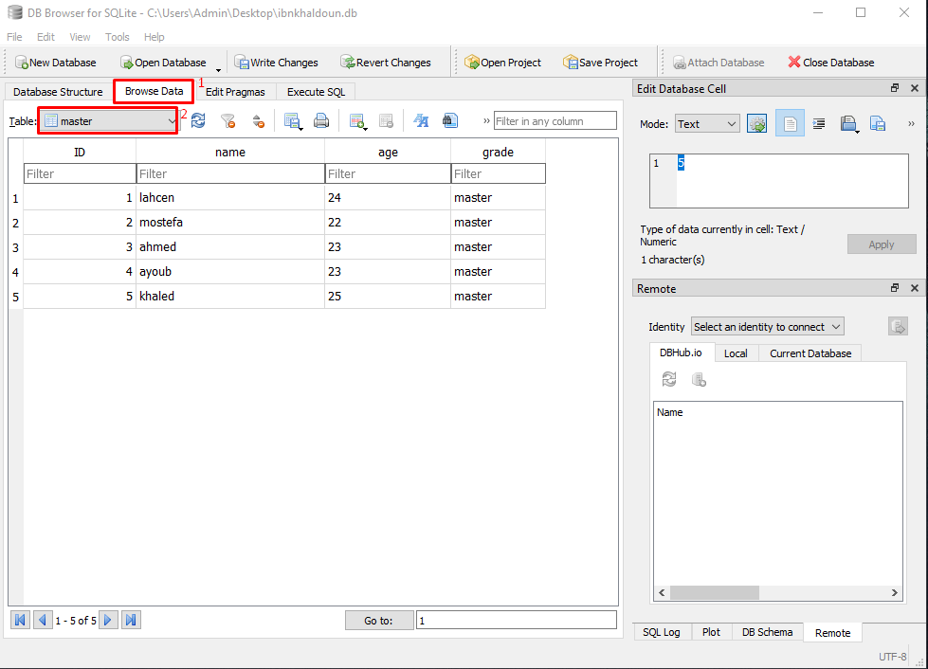
Data Selection
Select on “browse data”
Select the table
- And you will see the data in this table

Slide 39
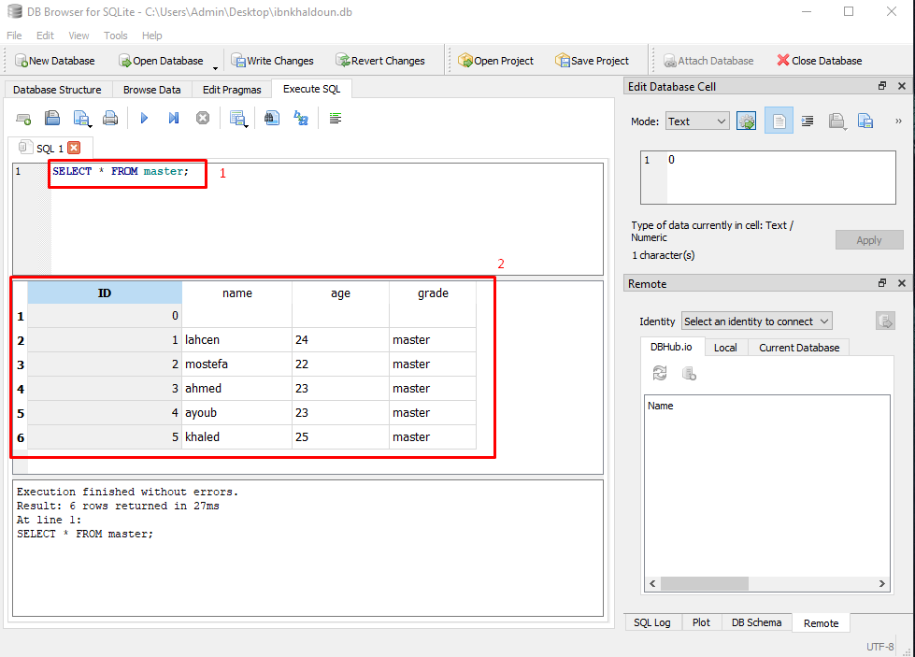
Data Selection
Write the query “select * ”
Execute the code

Slide 40
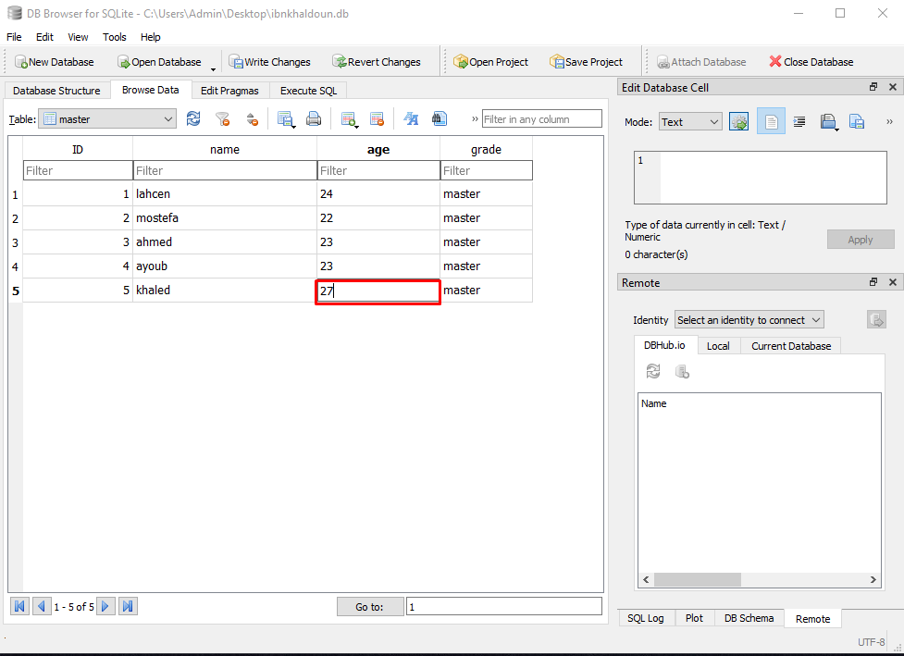
Data Update
- On browse data select the field you want to update and change the value and hit enter to save your changes

Slide 41
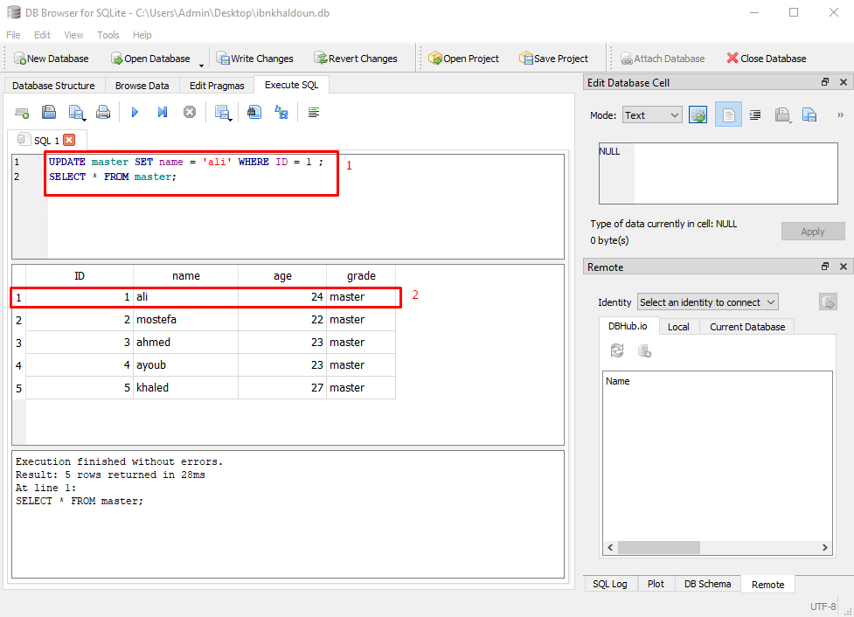
Data Update
Write the query “Update”
The data is updated successfully

Slide 42
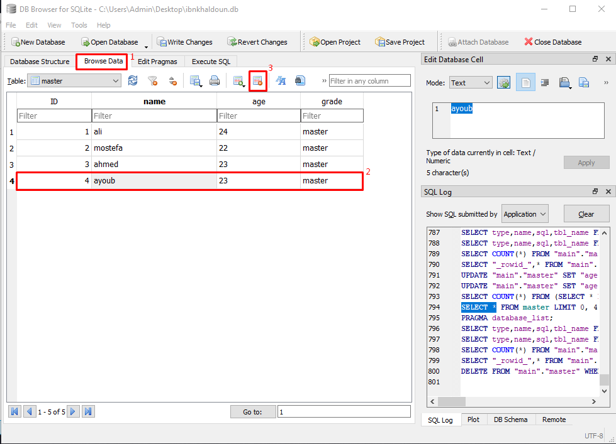
Data Suppression
Select on browse data
Select a row
Click on the button to delete the row

Slide 43
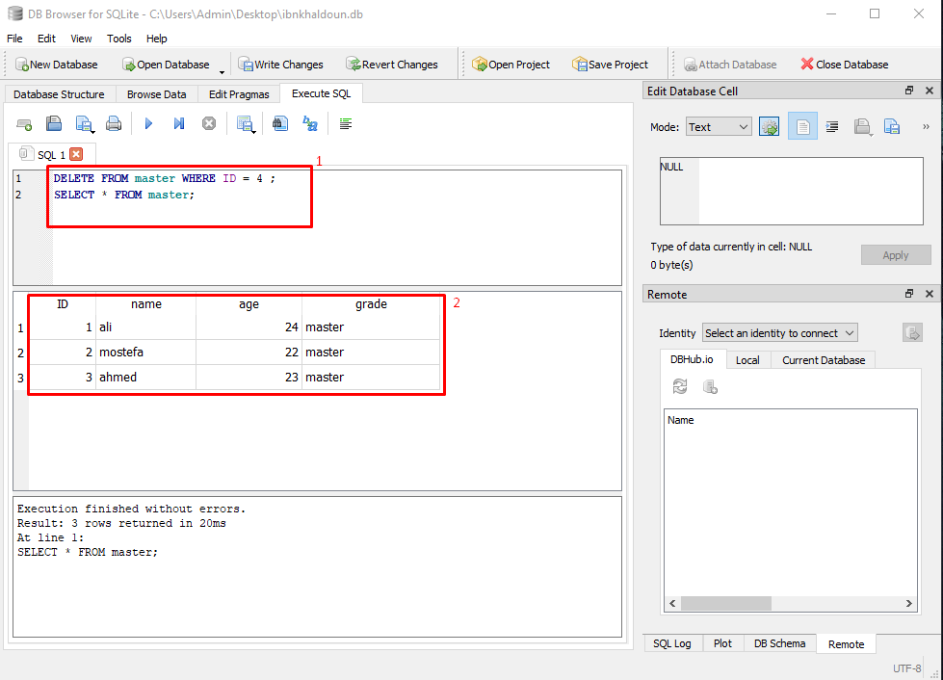
Data Suppression
Write the query “delete ”
The row is deleted

Slide 44
DCL (Data Control Language)

Slide 45
Access privileges Management doesn’t
exist in SQLite we will explore this point
further below.

Slide 46
TCL (Transaction Control Language)

Slide 47
SQLite Languages
We find in this language:
LOCKS
COMMIT
ROLLBACK
SAVEPOINT

Slide 48
Importance of DBMS Interfaces
DBMS are just like any software, needs an interface to :
Access and use the various services and features
Check the correct functioning of the system
System maintenance

Slide 49
Utilization of interactive interfaces
Utilization of SQL through command line
Utilization of SQLite tools like « DB Browser for SQLite »

Slide 50
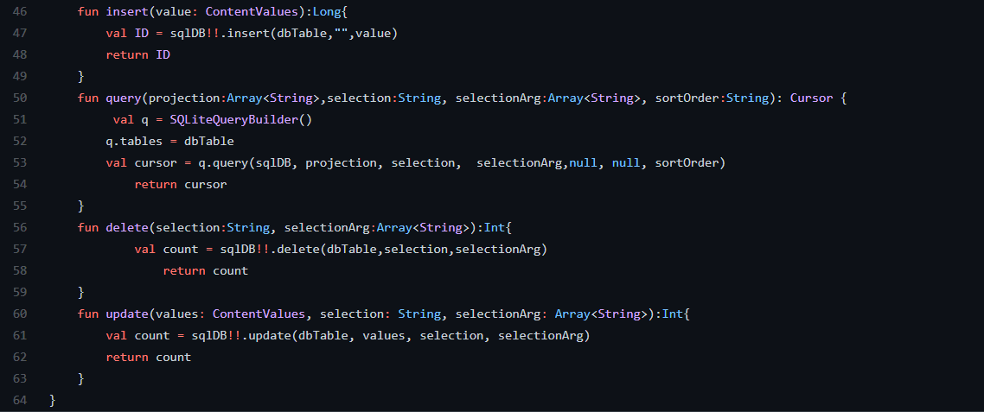
L’utilisation d’interface programmée
C’est l’interrogation du SGBD SQLite Via Un langage de programmation en utilisant SQL
Exemple : Insertion, Delete and Update in table through Kotlin language in Android

Slide 51
Security and
Access Permisions

Slide 52
The importance of Security in DBMS
Asserting Confidentiality : protection against data theft and infiltrations
Asserting Data Integrality
Block unauthorized Access

Slide 53
Access Permissions in SQLite
SQLite does not provide a control mechanism to access permissions
The only Access Permission is the one provided by the Operating System

Slide 54
Why the lack of SQLite Access Rights?
Number of users is Limited
Considered to be structured system files
Very low probability of attack or intrusion

Slide 55
Metadata &
Transactions

Slide 56
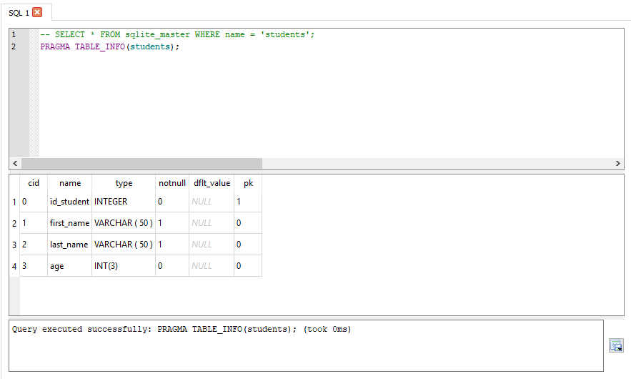
MetaData

Slide 57
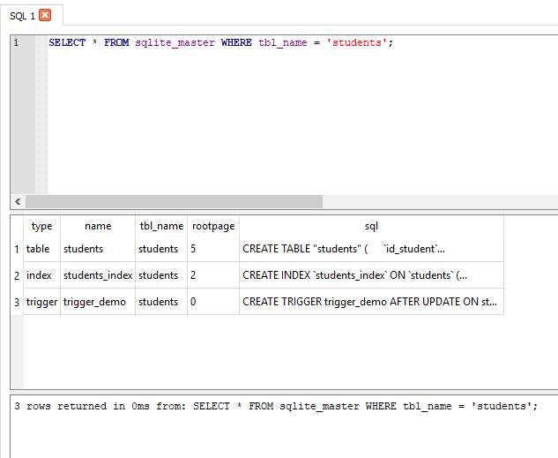
MetaData

Slide 58
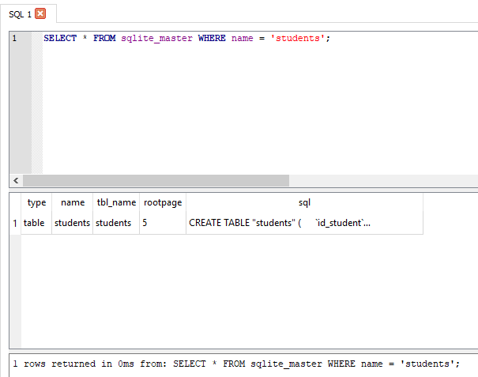
MetaData

Slide 59
Locks
There are 5 types of locks in SQLite, for each one of them there’s a lock unless the « unlocked » type which has no locks :
UNLOCKED : No session can do anything on data
SHARED : In this state, many sessions can read data simultaneously but, none can write.
RESERVED : One session at a time can write on the DB, this state can coexist with the state SHARED, changes will be stored in cache and won’t be modified on the disk.
EXCLUSIVE : Only when a session tries to validate changes or transactions
PENDING : Is when the process that hold the lock would like to write in the DB when possible and waits for all the shared locks are deleted so it can get the EXCLUSIVE lock.

Slide 60
Transactions Types
DEFERRED : By default a transaction is DEFERRED (doesn’t obtain any lock until necessairy).
IMMEDIATE : An IMMEDIATE transaction gets a RESERVED lock once the command BEGIN is executed.
EXCLUSIVE : An EXCLUSIVE transaction gets an EXCLUSIVE lock on the DB it guarantees that no other session is active in the DB and you can write or read from it with no conflicts.

Slide 61
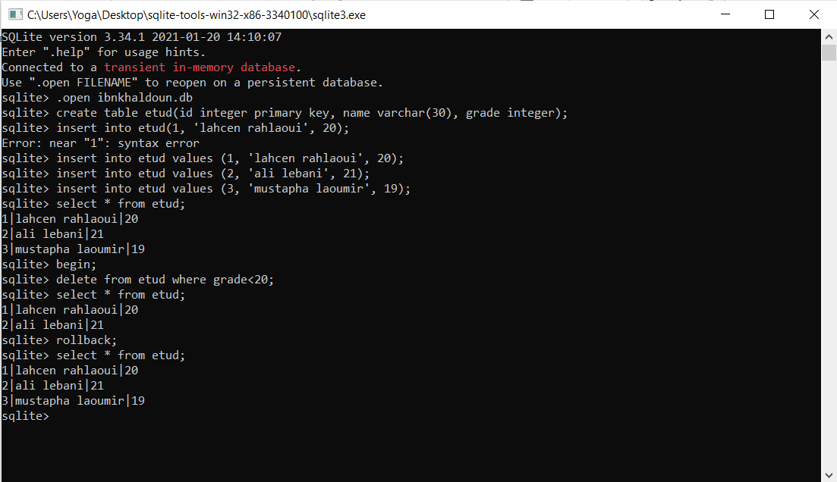
BEGIN et ROLLBACK
Example :
Deleted user that has
Grade<20
Then rollback to
Have the data
again.

Slide 62
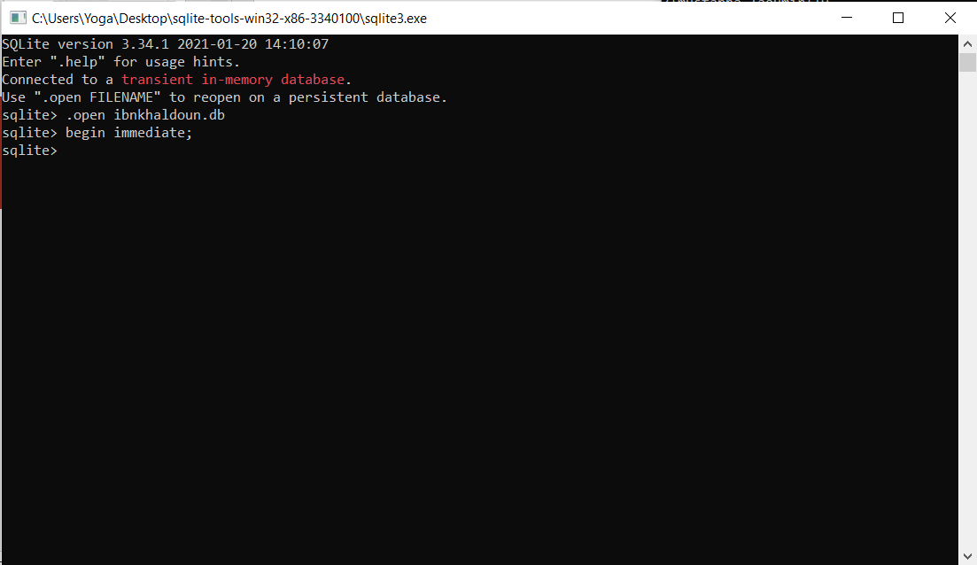
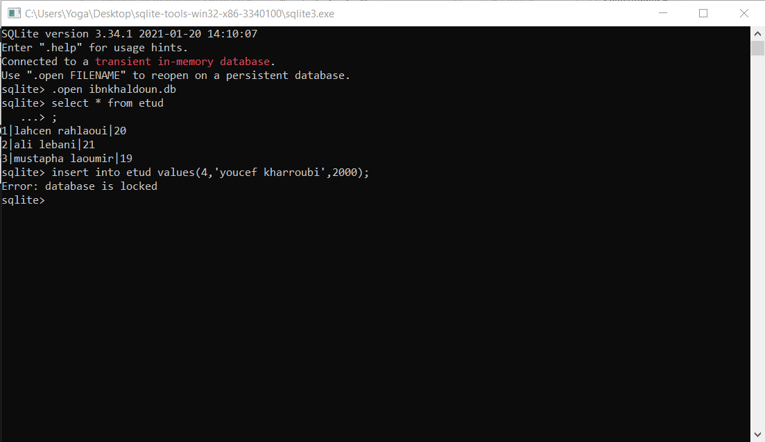
BEGIN IMMEDIATE
Example :
Two sessions simultaneously , writing is locked.
1
2
3

Slide 63
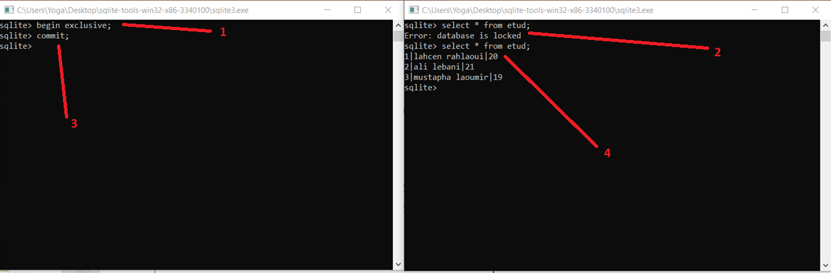
BEGIN EXCLUSIVE et COMMIT
Example :
Two sessions simultaneously, Read and Write are locked.

Slide 64
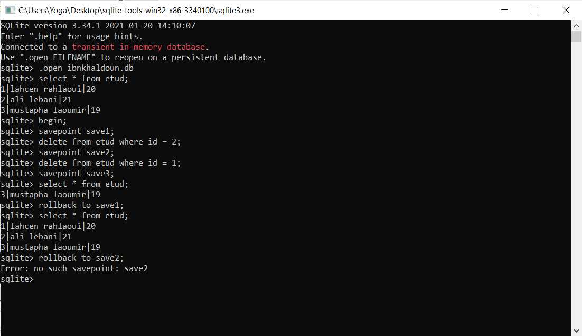
SAVEPOINT et ROLLBACK TO
Example :
Creating savepoints and rolling back to them.

Slide 65
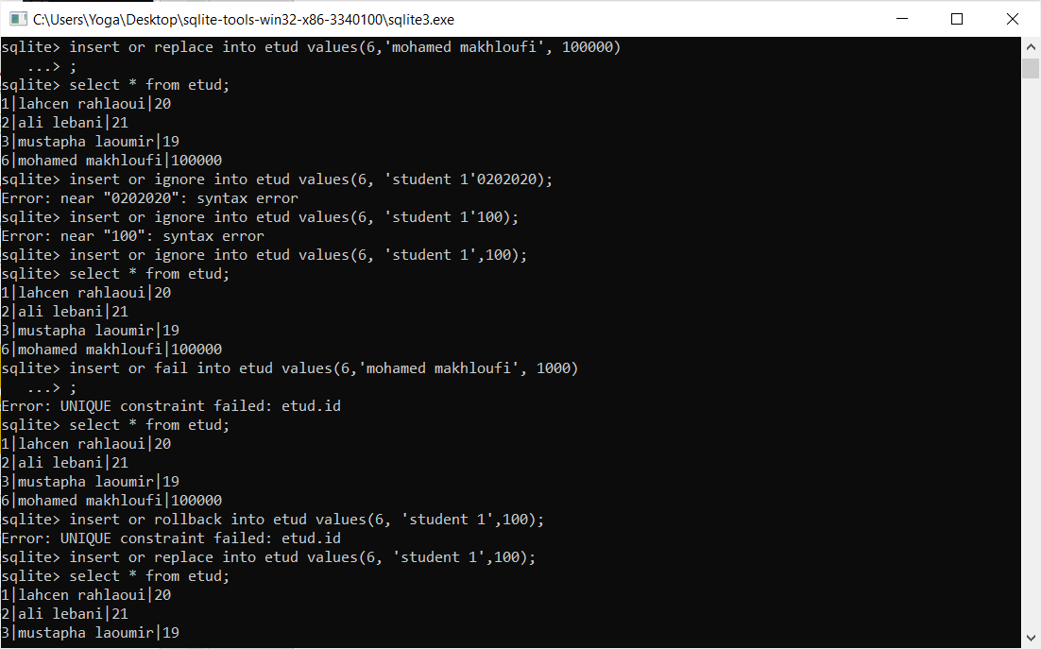
REPLACE, IGNORE, FAIL, ABORT
Example :
Data insertion that violates integrity consraints

Slide 66
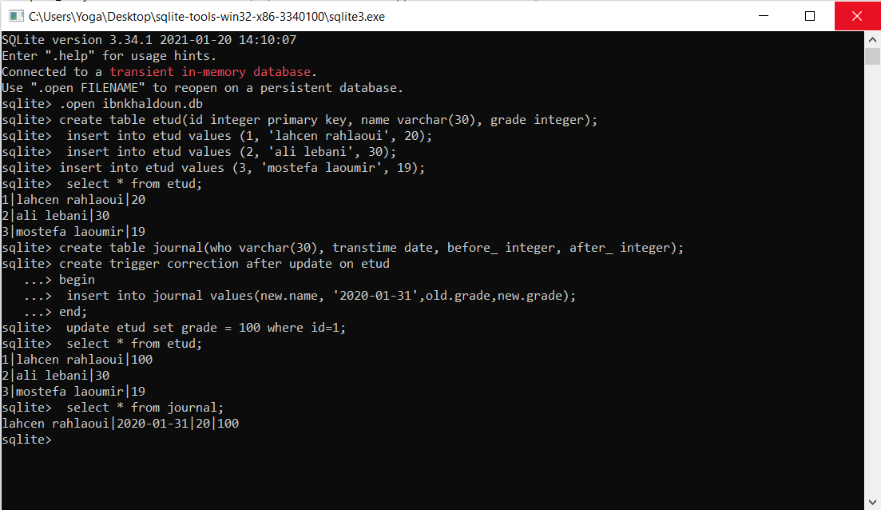
Journalisation with TRIGGERS
Example :
journal saving of a transaction using a trigger.

Slide 67
Advantages & disadvantages

Slide 68
Advantages
Easy to install, with almost zero configuration
Can be directly included in an application
Fast Development
Avaliable for most of the programing languages(java,c++,PHP…)
Open source

Slide 69
Disadventages
Can’t have acces restrictions such as grant/revoke
Not recommended for big databases

Slide 70
Difficultés rencontrés durant le travail

